Slide 1
1A-2 Measures of Angles

Slide 2
Change hours into hours and minutes.
Change 7.2 hours into hours and minutes.

Slide 3
Each degree of an angle is divided into 60 minutes ( ‘ ),
and each minute of a degree is divided into 60 seconds ( “ ).

Slide 4
Change each angle measure into degrees and minutes.

Slide 5
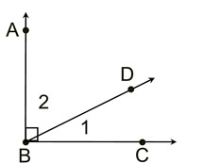

Slide 6
Change to degrees.

Slide 7
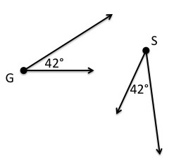
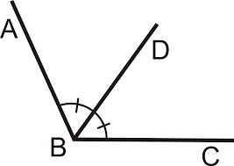
Congruent angles have the same measure.
Angles are congruent, while their measures ae equal.

Slide 8
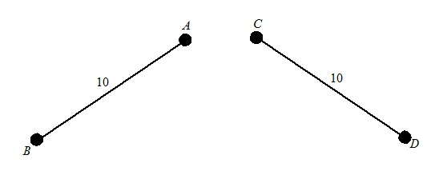
Congruent segments have the same length.

Slide 9
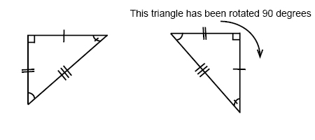
Tick marks

Slide 10
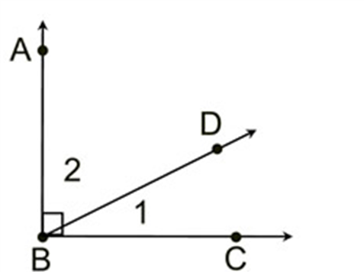
Find

Slide 11
is an acute angle.
What are the restrictions on ?
(decimal degrees)
B

Slide 12
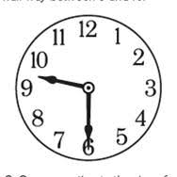
What is the angle formed by the hands of a clock at:
2:00
9:30

