Slide 1
Simplifying Radicals

Slide 2


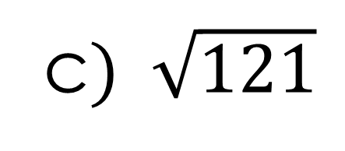
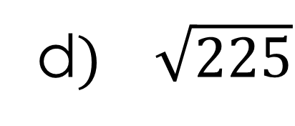
Simplify:
b)
$$\sqrt{16}$$
$$\sqrt{100}$$
c$) \sqrt{121}$
d$) \sqrt{225}$

Slide 3
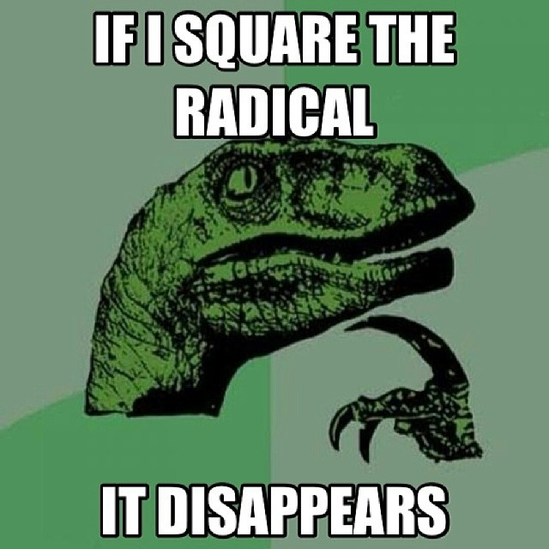
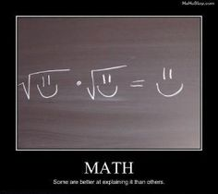
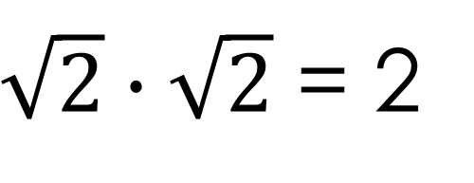
4-2 Simplifying Radicals
$\sqrt{2}∙\sqrt{2}$ = 2

Slide 4
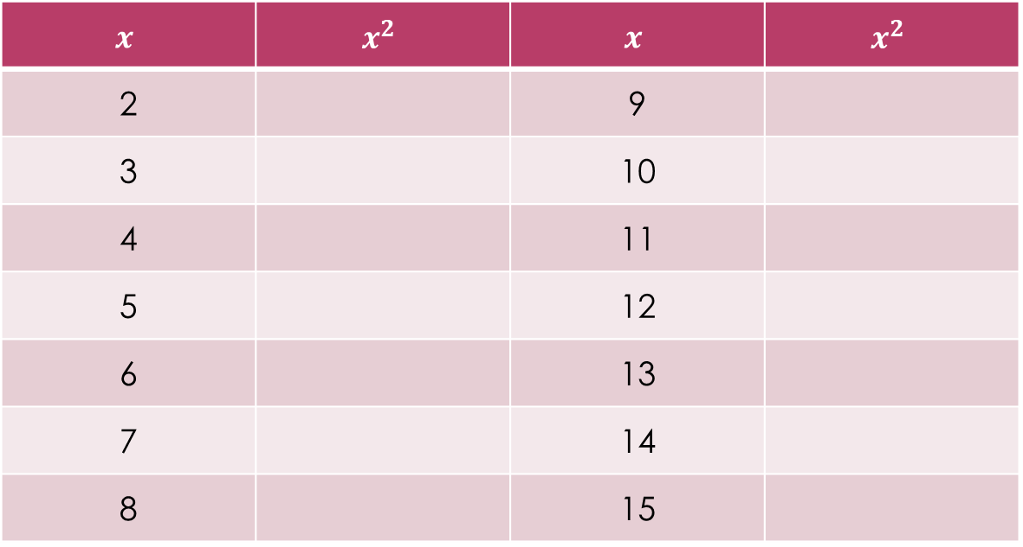
Memorize “Perfect Squares”
$$x$$ | $$x^{2}$$ | $$x$$ | $$x^{2}$$
2 |  | 9
3 |  | 10
4 |  | 11
5 |  | 12
6 |  | 13
7 |  | 14
8 |  | 15

Slide 5
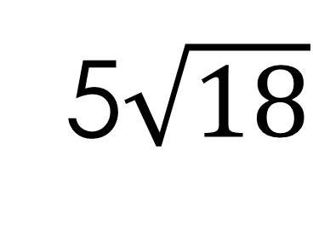
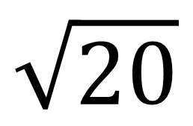
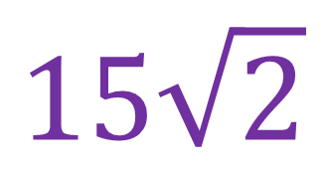
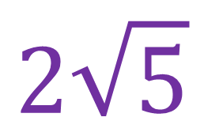
Simplify Radicals
$$\sqrt{20}$$
5$\sqrt{18}$
$$2\sqrt{5}$$
$$15\sqrt{2}$$

Slide 6
To Multiply Radicals Outside times outside Radicand times Radicand (ie. Inside times inside)

Slide 7
$$\sqrt{7}∙\sqrt{3}=\sqrt{21}$$
$$3\sqrt{11}∙2\sqrt{3}=6\sqrt{33}$$

Slide 10
Rationalize the Denominator (Eliminate square root on the bottom)

Slide 12

To Simplify (known as “rationalize the denominator”)
Multiply by 1
$$\frac{5}{\sqrt{3}}$$

Slide 13

$$\frac{7}{\sqrt{5}}$$
$$\frac{6}{\sqrt{3}}$$
$$\frac{3\sqrt{6}}{\sqrt{2}}$$

Slide 14
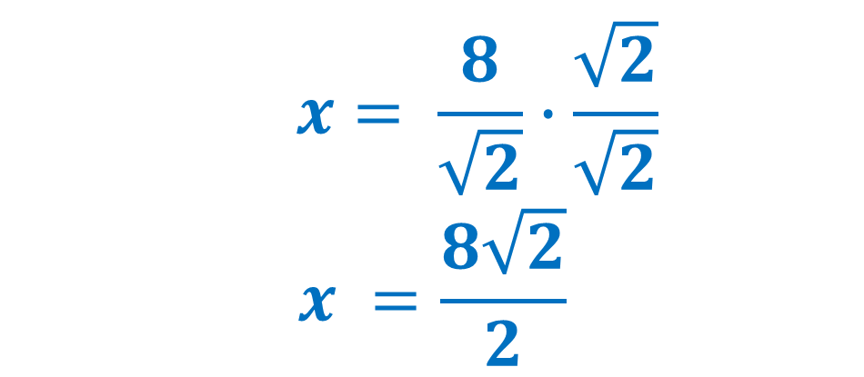
Solve
$$x= \frac{8}{\sqrt{2}}∙\frac{\sqrt{2}}{\sqrt{2}}$$
$$x =\frac{8\sqrt{2}}{2}$$

