Slide 1
Warm Up:

Slide 2

4-5 Quadratic Formula Discriminant
& Types of Solutions

Slide 3
You can solve a quadratic by using a Formula
Discriminant: b²-4ac
Quadratic formula
Notice where the discriminant is in the quadratic formula!

Slide 4
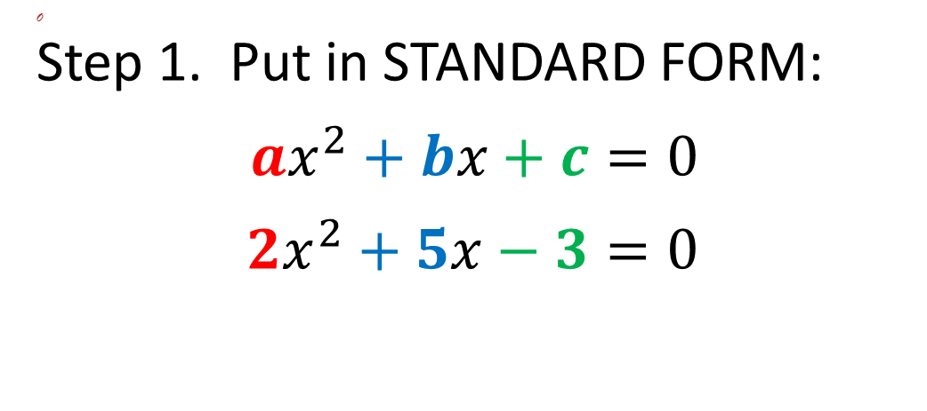
How do you find the discriminant?
Step 1. Put in STANDARD FORM:
$ax^{2}+bx+c=0$
$2x^{2}+5x−3=0$

Slide 5
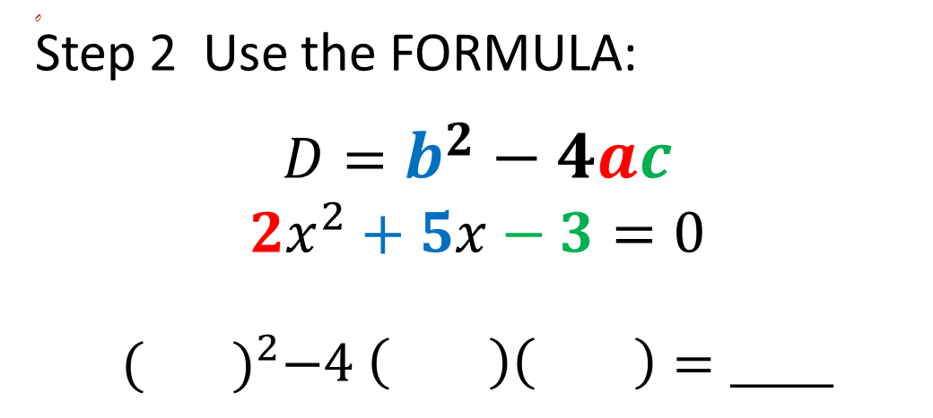
How do you find the discriminant?
Step 2 Use the FORMULA:
$$D=b^{2}−4ac$$
$$2x^{2}+5x−3=0$$
$$({ )}^{2}−4 \left( \right)\left( \right)=_____$$

Slide 6
What does the discriminant of a quadratic equation tell us about the solutions?
When:
D > 0 (positive)
2 real solutions
Number: 2
Type: Real

Slide 7
What does the discriminant of a quadratic equation tell us about the solutions?
When:
D = 0
1 real solution
Number: 1
Type: Real

Slide 8
What does the discriminant of a quadratic equation tell us about the solutions?
When:
D < 0 (negative)
NO real solutions
OR
Number: 2
Type: Imaginary

Slide 9
Solutions
are also called:
Roots
or
Zeroes

Slide 10
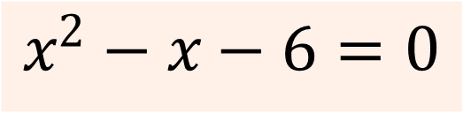
Find the Discriminant & the number and type of solutions
$$x^{2}−x−6=0$$

Slide 11

Find the Discriminant & the number and type of solutions
$${3x}^{2}−6x+3=0$$

Slide 12
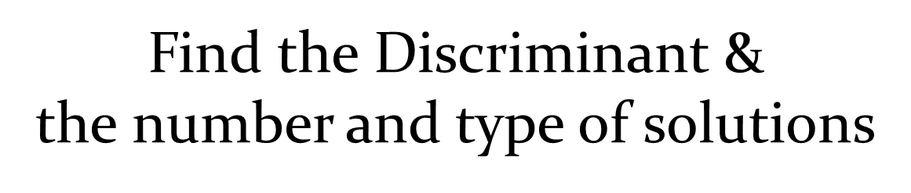
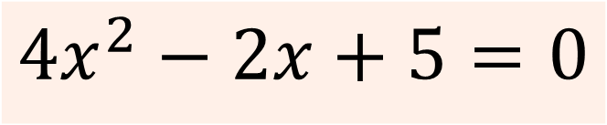
$${4x}^{2}−2x+5=0$$

Slide 13
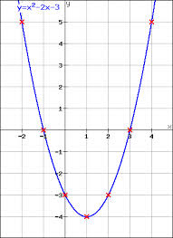
How many solutions?
What type?
If it’s a graph, you can also
find the solutions
without doing
any calculations!
What are the solutions?

Slide 14
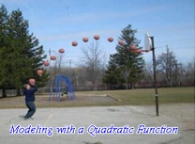
Solve a quadratic by using a Formula

Slide 15
You can solve a quadratic by using a Formula
Discriminant: b²-4ac
Quadratic formula
Notice where the discriminant is in the quadratic formula!

Slide 16

The Quadratic Formula
Solve using Quadratic Formula

Slide 17
Using the Quadratic Formula
2x² - 3x + 5 = 0
or

Slide 18
Using the Quadratic Formula
First, put in standard form
2x² – x = -2
2x² – x + 2=0

Slide 19
Using the Quadratic Formula
3x² – 8x + 10 = 3
or split into 2 fractions
and simplify.

