Slide 1
GSE Geometry
Unit 1 Transformations in the Coordinate Plane

Slide 2
Rigid Motion – the image and preimage are congruent.

Slide 3
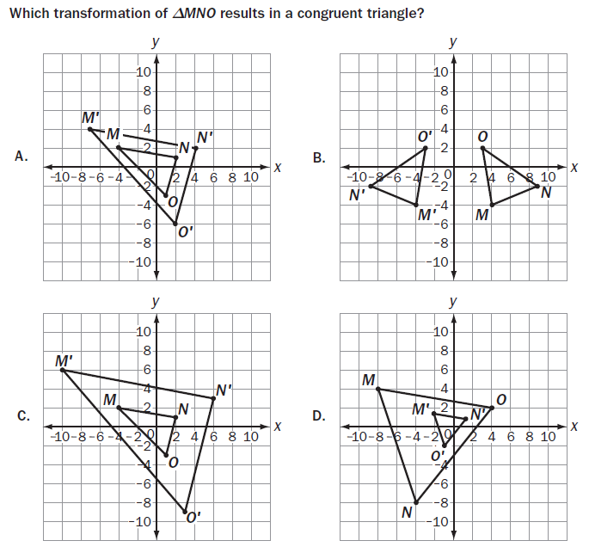
Example

Slide 4
Solution

Slide 5
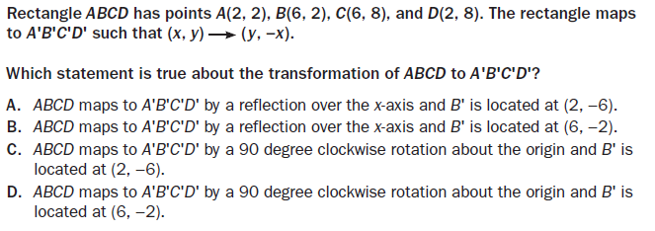
Example

Slide 6
Solution

Slide 7
Example

Slide 8
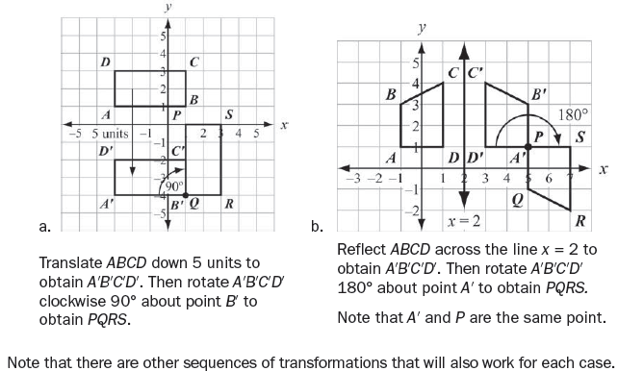
Solution

Slide 9
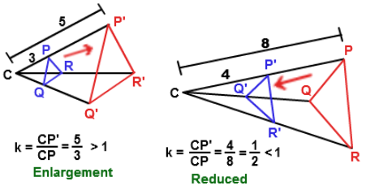
Non-Rigid Motion – the image and preimage are not necessarily congruent.
Scale factor (k) = the NEW length over the OLD length. For k > 1, the figure is enlarged, for k < 1, it is reduced.

Slide 10
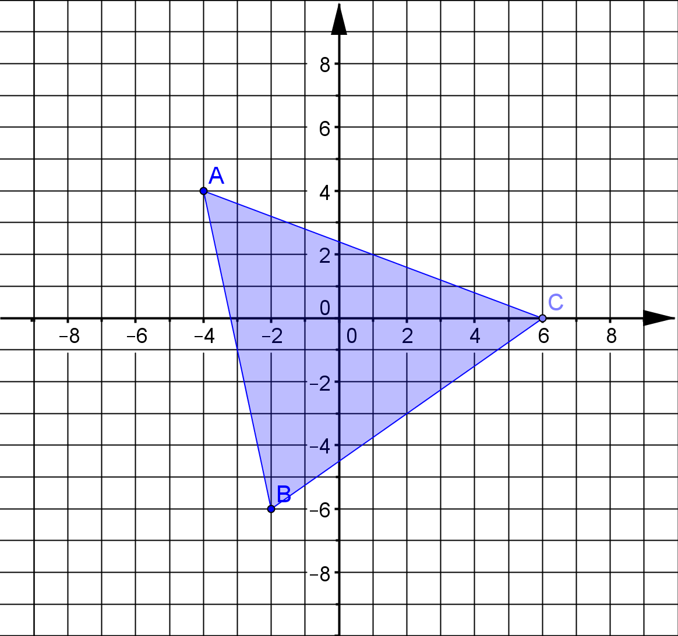
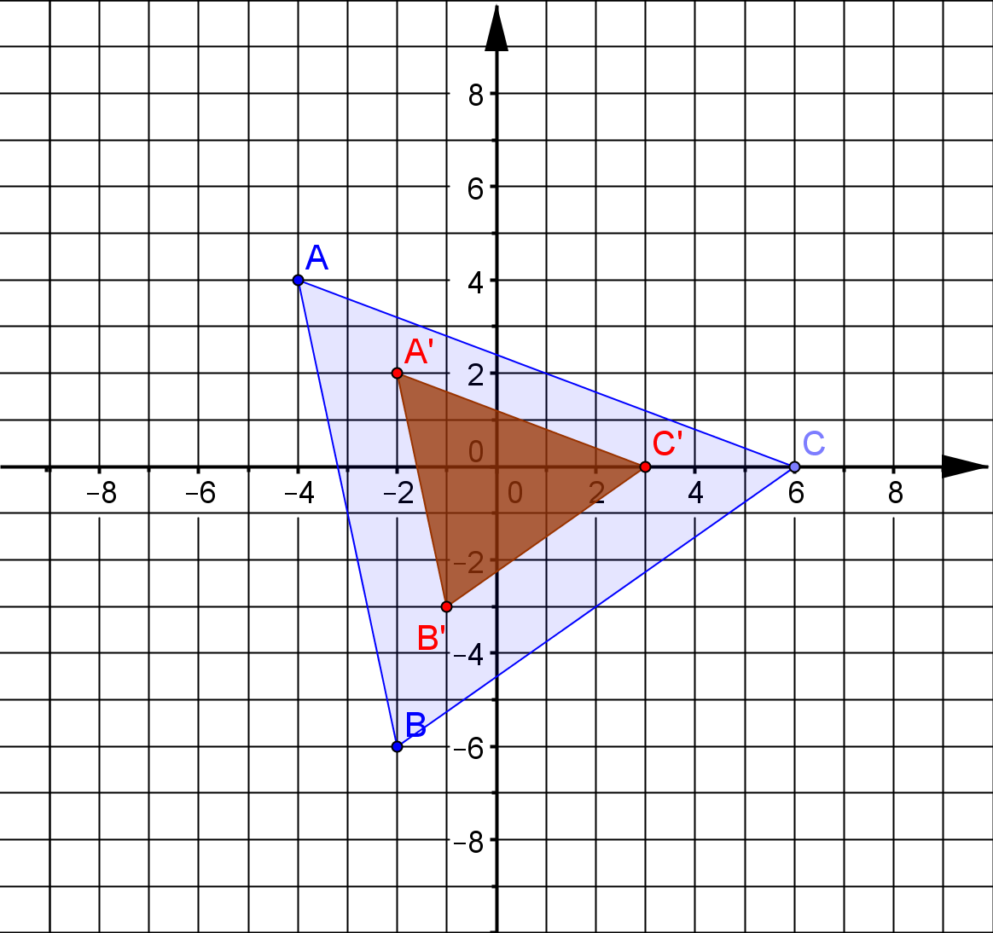
Dilate the figure by 1/2. Use the origin as the center of dilation.

Slide 11
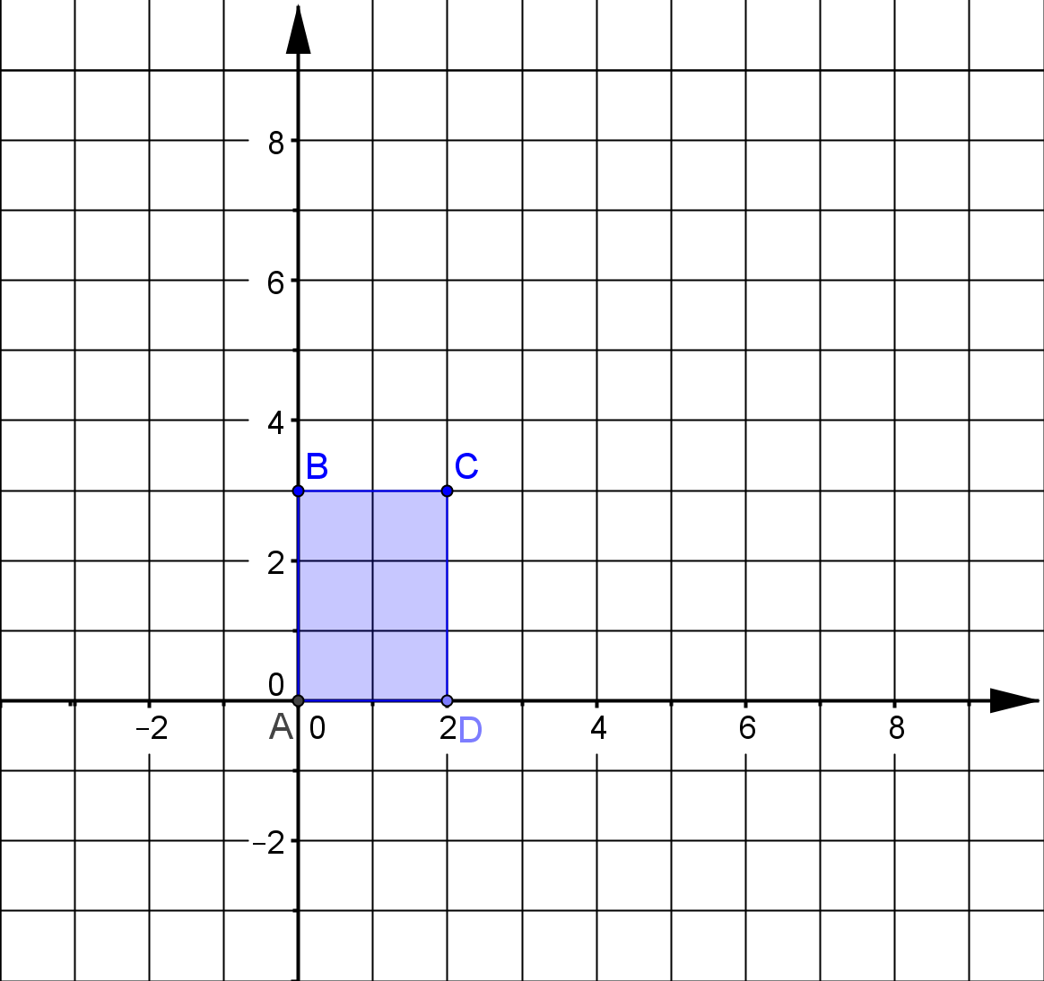
Dilate the figure by 2. Use (-2,0) as the origin as the center of dilation.
To do this, you have to calculate the distance each point is away from the center of dilation and then multiply that distance by the dilation factor.

Slide 12
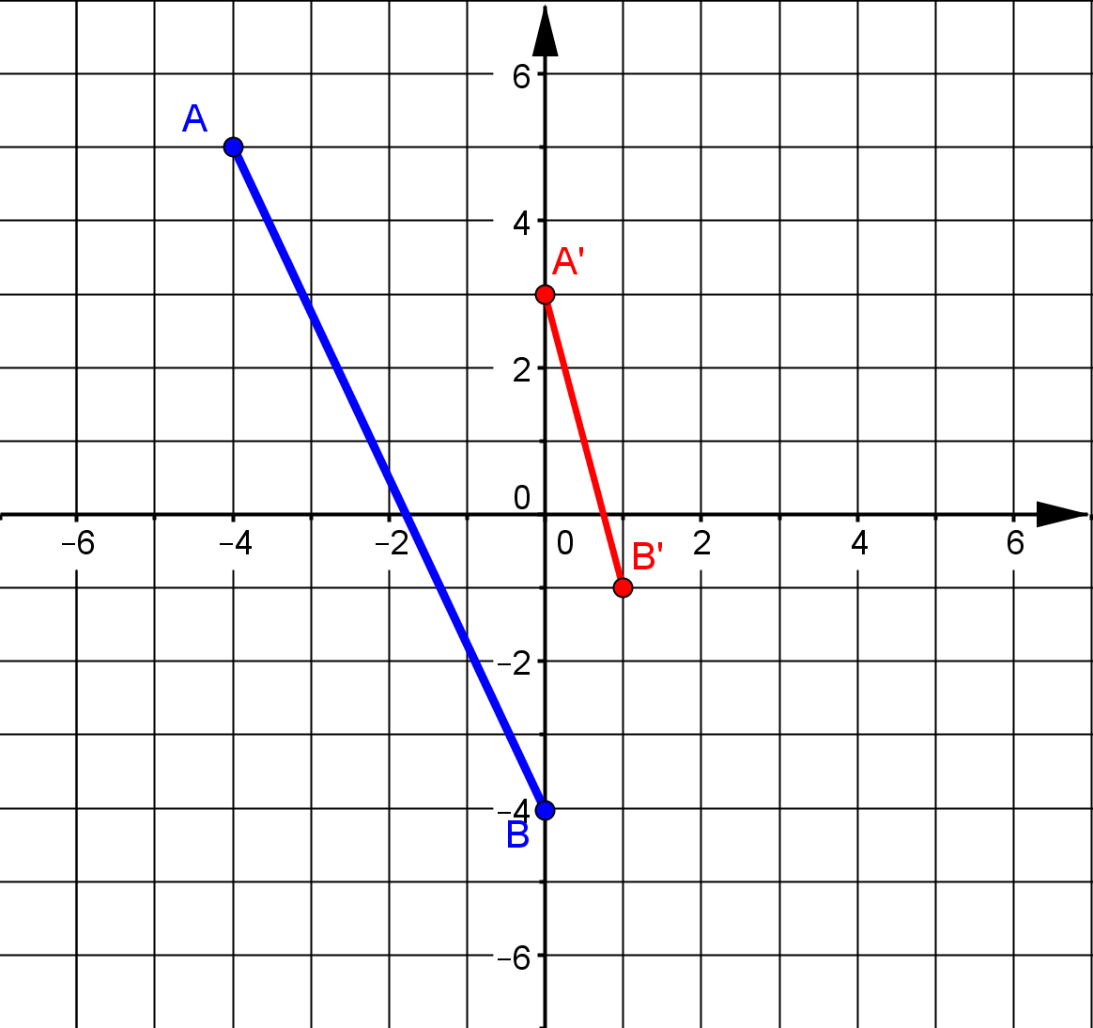
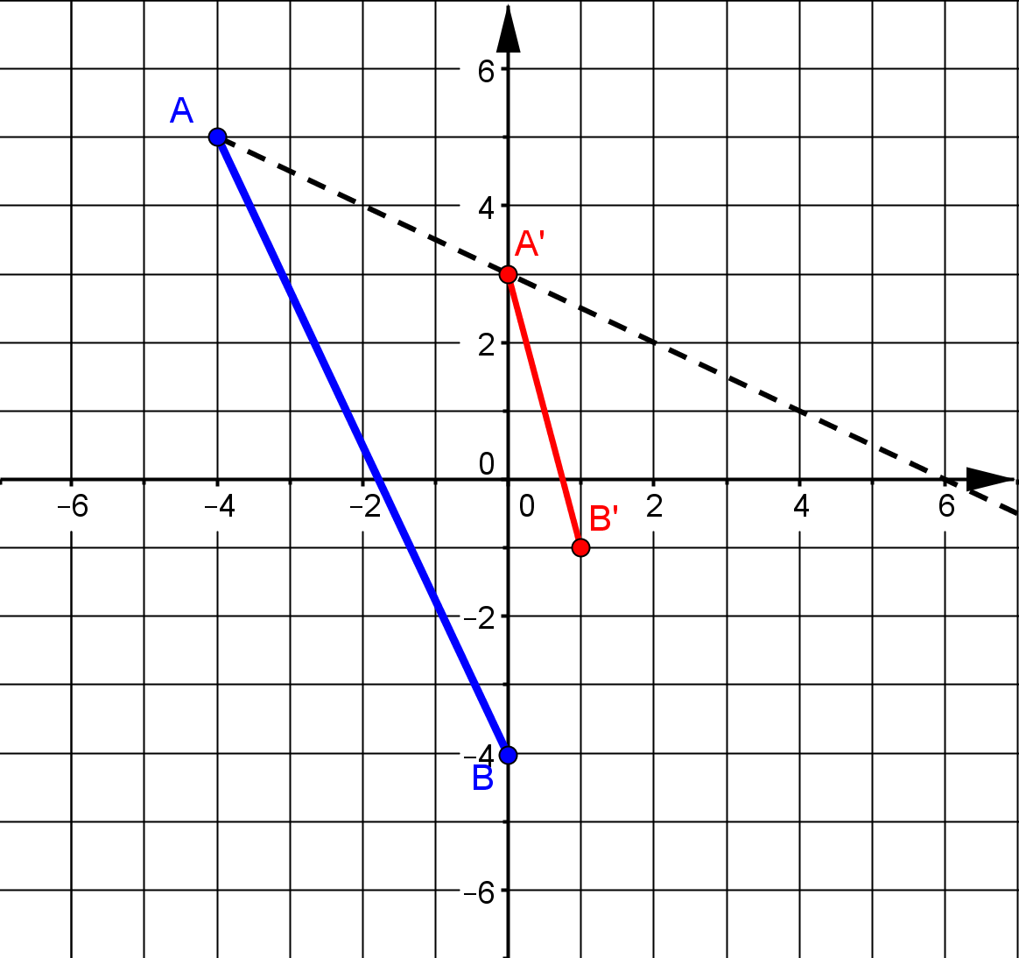
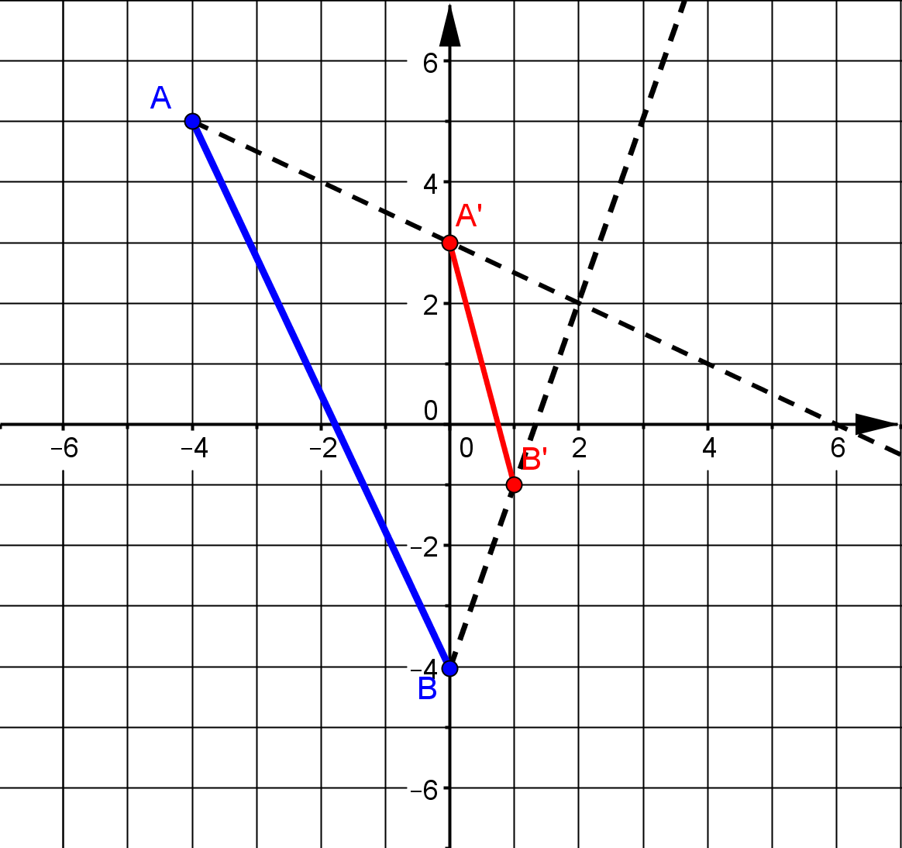
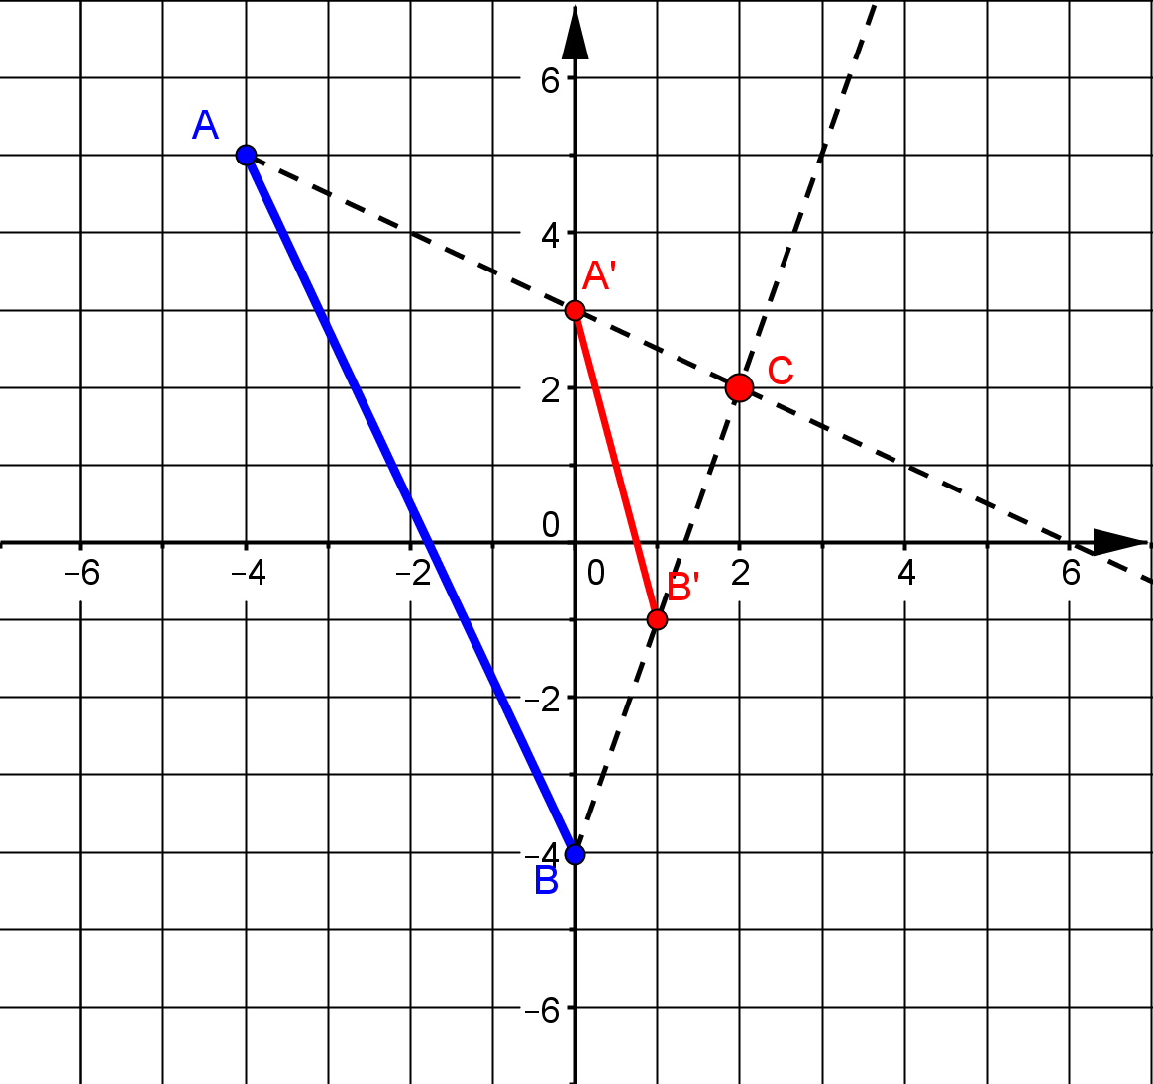
Find the center of dilation

