Slide 1
GSE Geometry
Unit 3: Right Triangle Trigonometry

Slide 2
Trig Ratios

Slide 3
Trig Ratio
What is cos R?
What is sin R?
What is tan R?

Slide 4
Co-Function Relationships

Slide 5
Co-Function Relationships
Cos 64° = Sin ____
26°

Slide 6
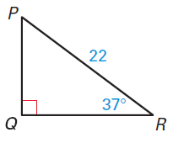
Find a Missing Side
Solve for x. Round to the nearest tenth.
x
x = 17.6

Slide 7
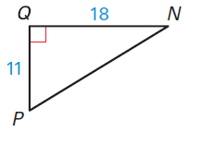
Find a Missing Angle
Solve for θ. Round to the nearest tenth.
θ
θ = 31.4°

Slide 8
The angle of elevation from a ship to the top of a 35 meter lighthouse on the coast measures 26°. How far from the coast is the ship? Round to the nearest tenth.
tan 26 = 35/x
x = 71.8 m

Slide 9
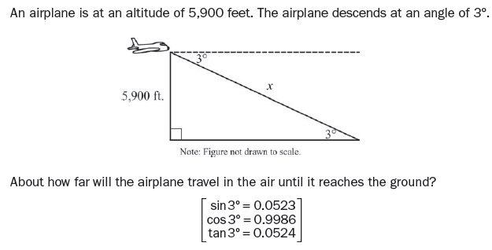
sin 3º = 5900/x
x = 113,000
The plane will travel about 113,000 feet before reaching the ground.

