Slide 1
GSE Geometry
Unit 5 Geometric and Algebraic Connections

Slide 2
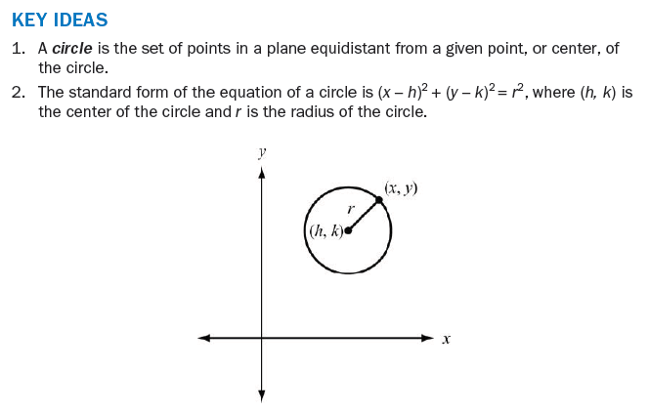
Circles

Slide 3
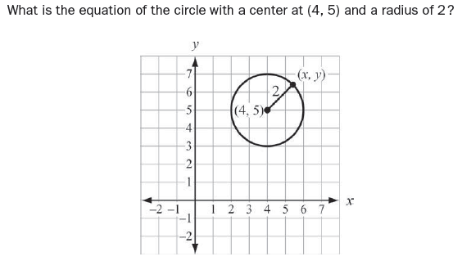
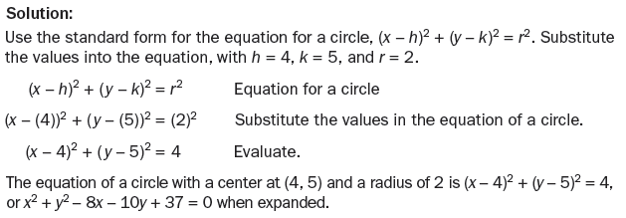
Example

Slide 4
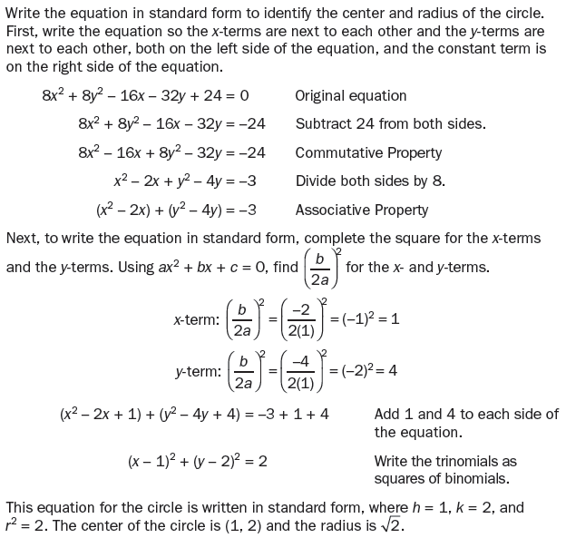
Example

Slide 5
Formulas

Slide 6
Using these Formulas

Slide 7
Example

Slide 8
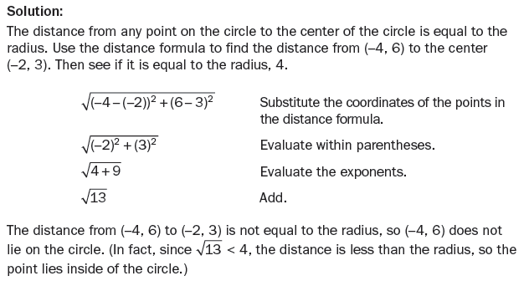
Example

Slide 9
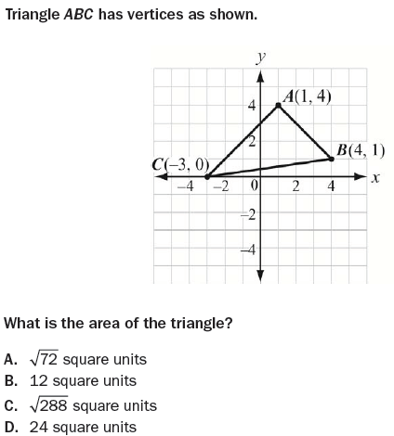
Example
Solution: B

Slide 10
Partition a Directed Segment

Slide 11
Equations of Lines
Slope-intercept form of a line: y = mx + b, where m is the slope and b is the y-intercept
Two lines are parallel if their slopes are the same.
Two lines are perpendicular if the product of their slopes is -1 (the slopes are negative reciprocals of each other).
Point-slope form of a line: y – y₁ = m(x – x₁)

Slide 12
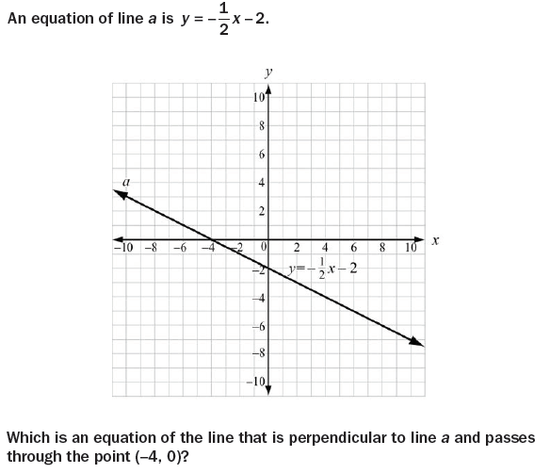
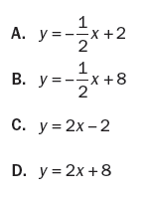
Example
Solution: D

