Slide 1
GSE Geometry
Unit 6: Applications of Probability

Slide 2
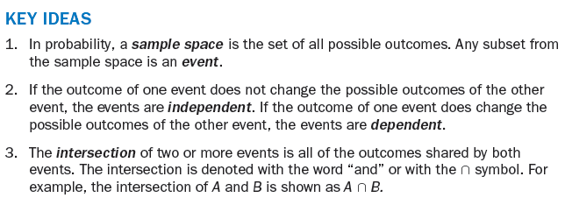
Key Ideas

Slide 3
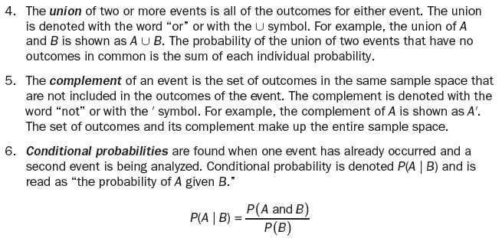
Key Ideas

Slide 4
Key Ideas

Slide 5
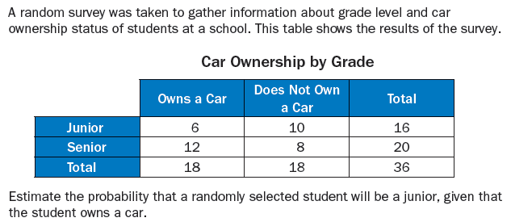
Example

Slide 6
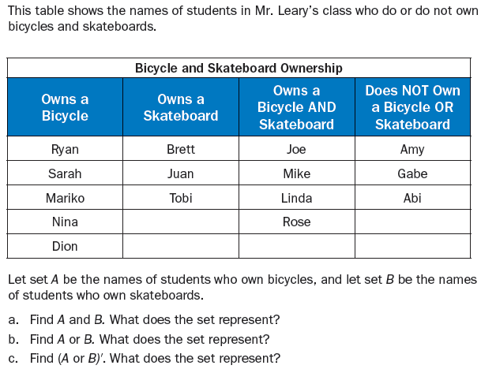
Example

Slide 7
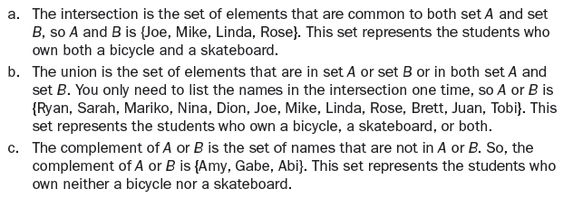
Solution

Slide 8
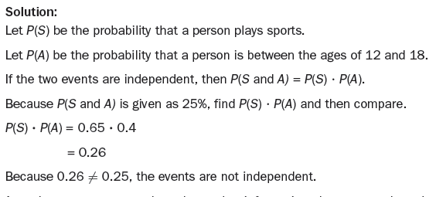
Example

Slide 9
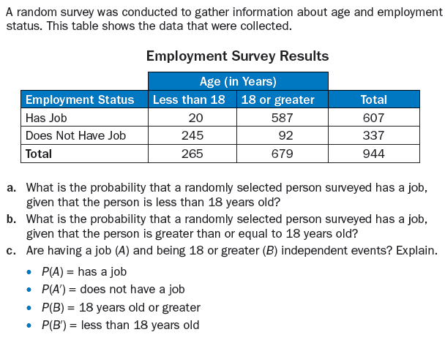
Example

Slide 10
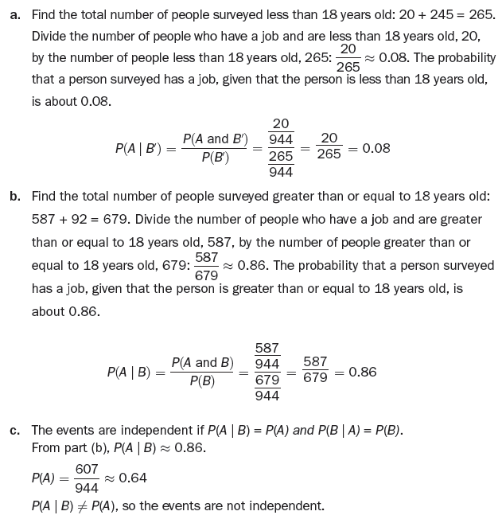
Solution:

Slide 11
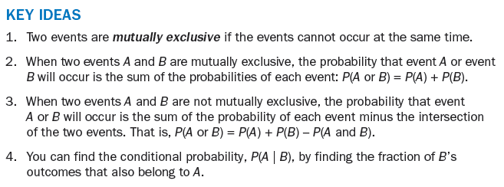
Mutually Exclusive Events

Slide 12
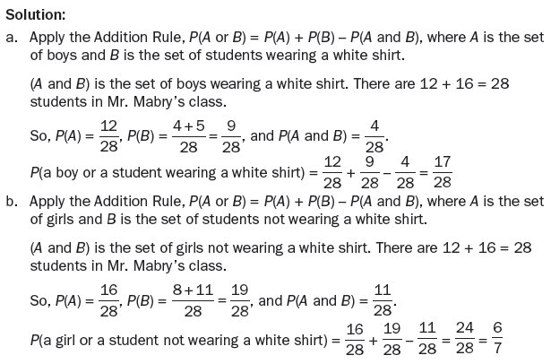
Example

